Slide 1
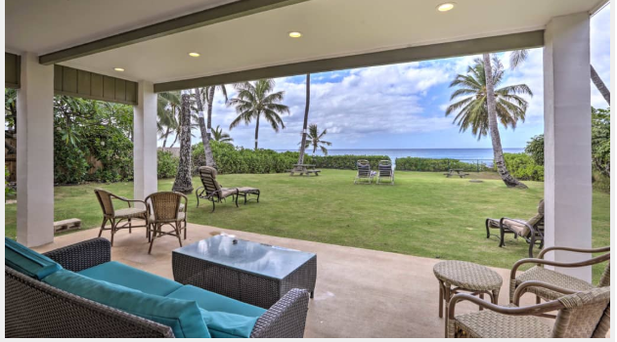

Group 1
Analysis of Airbnb in Hawaii
Jolinda Dirks : Pam Garner : Connie Conine : James Mitchell

Slide 2
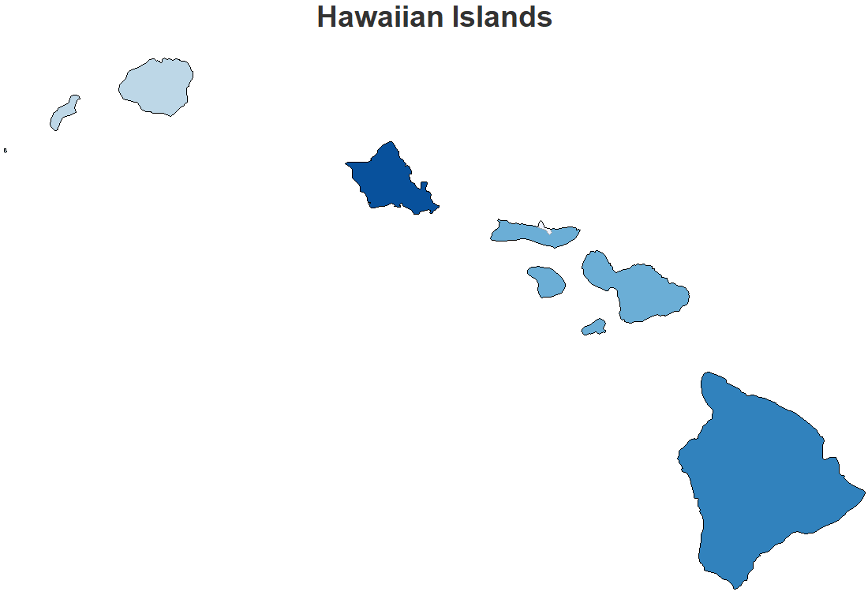
Agenda
Introduction
Airbnb Summary
Superhost
BeachFront
Hawaii
Top Five Recommendations
Conclusion

Slide 3

Introduction

Slide 4
Introduction : Data
Data: http://insideairbnb.com/get-the-data.html
Two CSV files
File 1
listings.csv
22,275 Observations / 16 variables
File 2
listings.csv.gz
22,275 Observations / 106 variables

Slide 5
Introduction : Key Variables
Amenities
Four Islands
Price
Property Type
Review Scores
SideofIsland
Superhost

Slide 6
Introduction: Questions and Hypothesis
Q1. How does the rating and cost of the Airbnb effect it's success?
H1. A better rating will follow a Superhost.
Q2. How does price vary with location?
H2. The closer the Airbnb is to the beach, the more expensive the stay will be.

Slide 7
Introduction: Deliverables
Top five Airbnb's in Hawaii based on property type.

Slide 8
Airbnb Summary

Slide 9
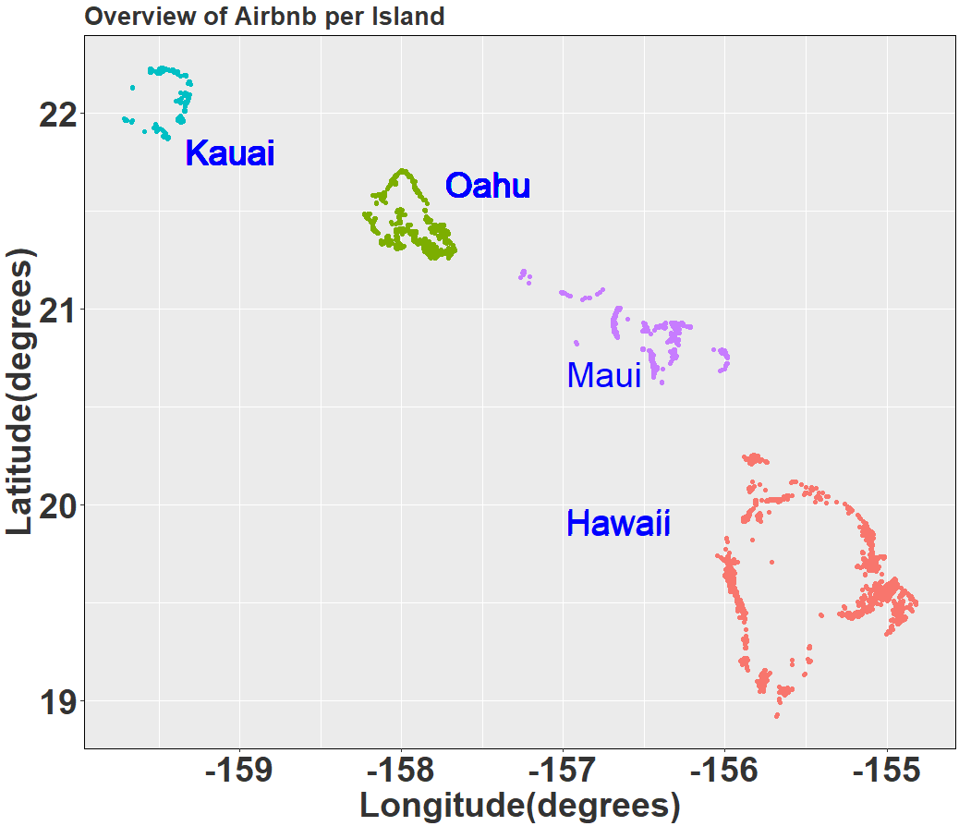
Airbnb Summary
Islands
Kauai
Oahu
Maui
Hawaii
Airbnb per Island
Kauai | Oahu | Maui | Hawaii | Total
2205 | 5051 | 4977 | 4385 | 16,618

Slide 10
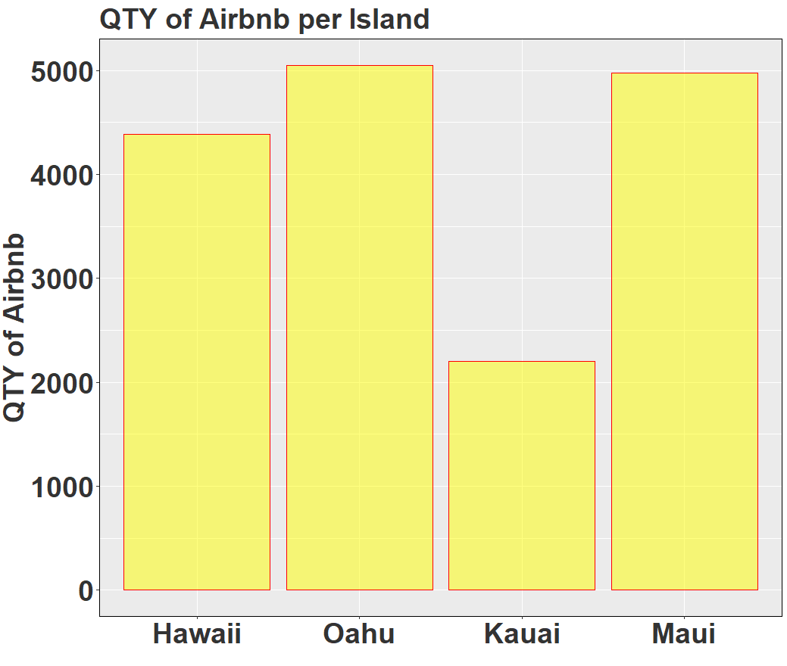
Airbnb Summary
Airbnb per Island
Kauai | Oahu | Maui | Hawaii | Total
2205 | 5051 | 4977 | 4385 | 16,618

Slide 11
Summary
4 Islands of interest
Airbnb’s are relatively disbursed across Islands
Hawaii has 26% of Airbnb population

Slide 12
Superhost

Slide 13

Superhost
Distinguishing feature among Airbnb

Slide 14
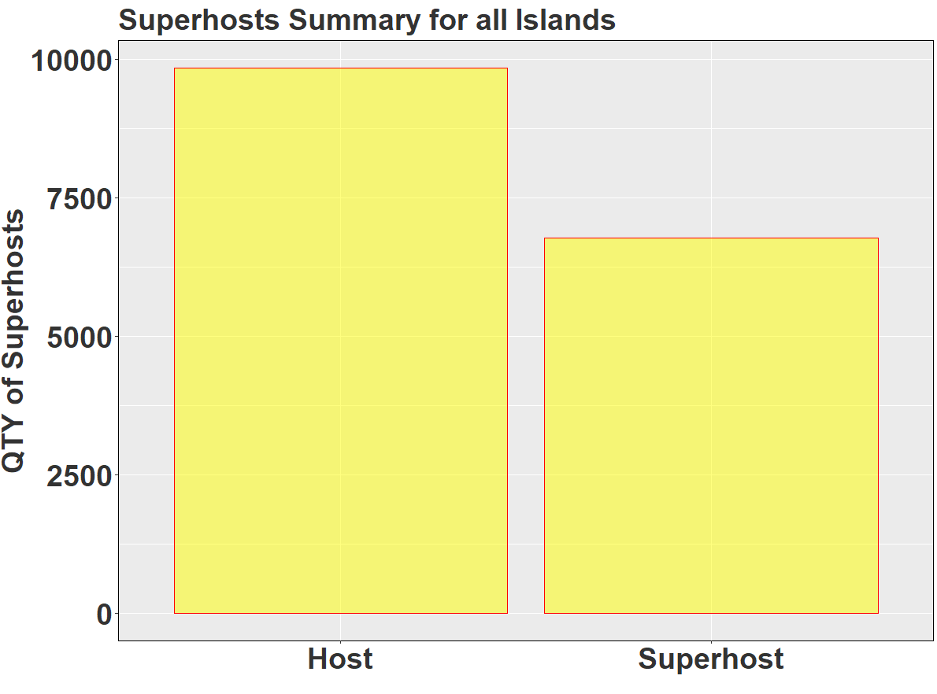
Superhost Summary for all Islands
Host | Superhost
9,842 | 6,776

Slide 15

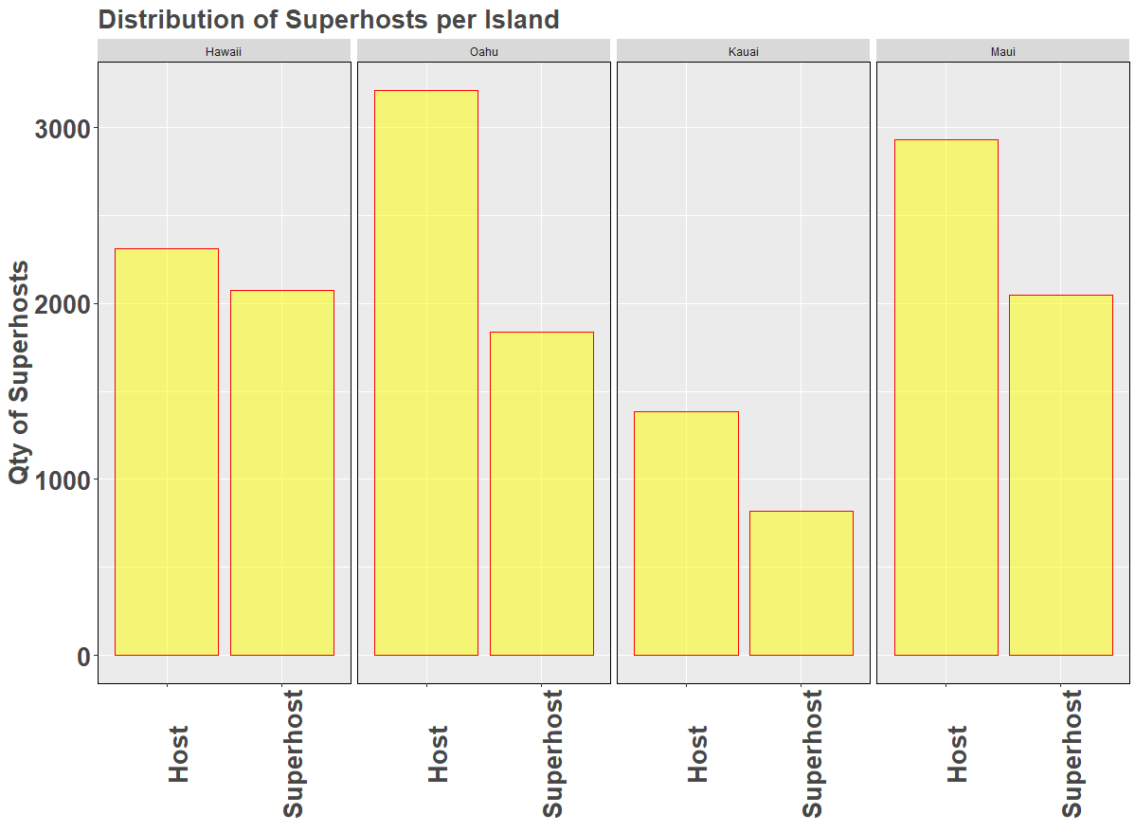
SuperHosts per Island

Slide 16
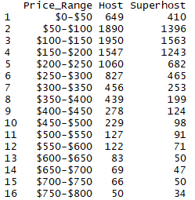
Quantity of Superhosts per Price Bin
Price Bin[$100:$150] has most Superhosts

Slide 17
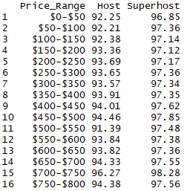
Average Ratings for Superhosts per Price Bin
Ratings increase by 5% for Superhosts

Slide 18
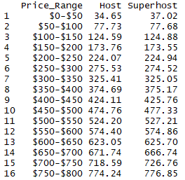
Average Price for Superhosts per Price Bin
No difference in Average price

Slide 19
Summary
Superhost is preferred
41% Airbnb’s are Superhosts
Hawaii has most Superhosts
Most Superhosts Airbnb are in the Price Range[$100:$150]
Ratings for Superhosts are 5% higher
No difference in Average price between Hosts

Slide 20
Question 1: How does the rating and cost of the Airbnb effect it's success?
Answer:
No difference in Average price between Hosts
Ratings for Superhosts are 5% higher

Slide 21
BeachFront
Notes:
Aren’t you VP Student Life?

Slide 22
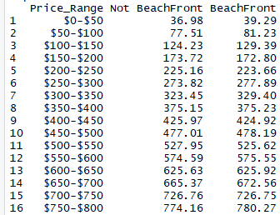
Price per Proximity to Beach
Question 2: How does price vary with location?
Answer : Superhosts slightly more expensive closer to beach

Slide 23
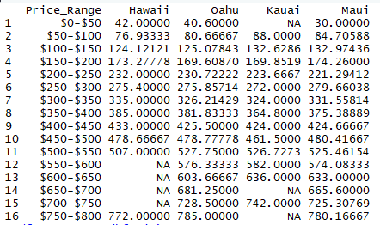
Price per Proximity to Beach across all Islands and Superhost
Hawaii is slight less expensive

Slide 24
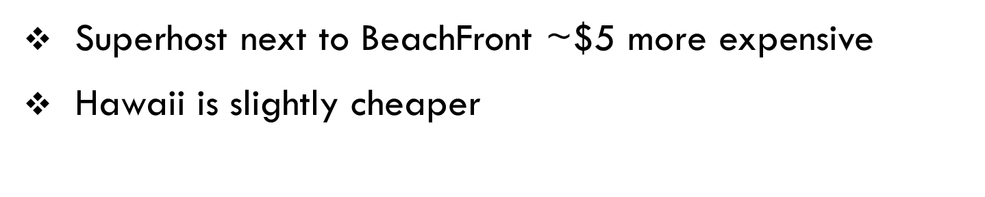
Question 2 : How does price vary with location
Answer : Superhosts slightly more expensive closer to beach

Slide 25
Hawaii
Notes:
Aren’t you VP Student Life?

Slide 26
SUBSETTED DATA
Airbnb for all Islands
16,618
6,776
39
2,073
937
Superhost
Hawaii
Beachfront
$100-$150
There are 39 Airbnb in Hawaii categorized as Superhosts and BeachFront in the Price Range of [$100:$150].

Slide 27
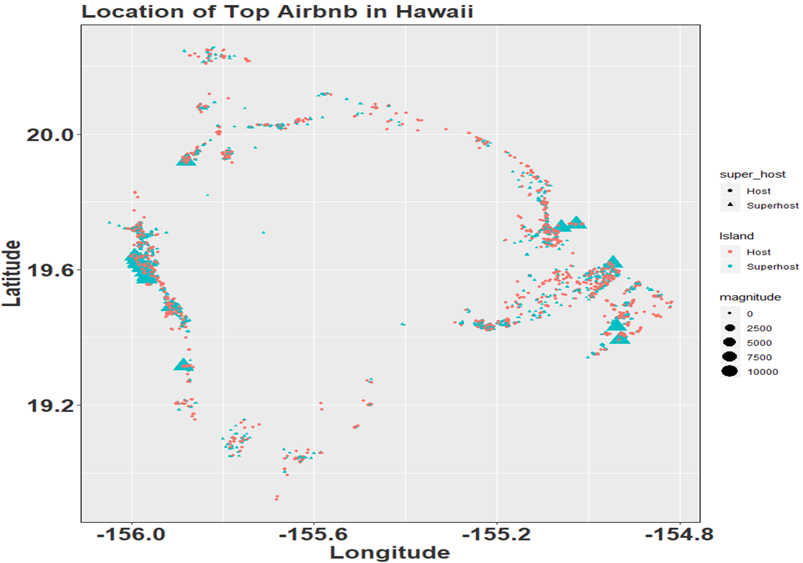
Hawaii : Location
Hawaii has 39 Superhost/BeachFront/[$100:$150]

Slide 28
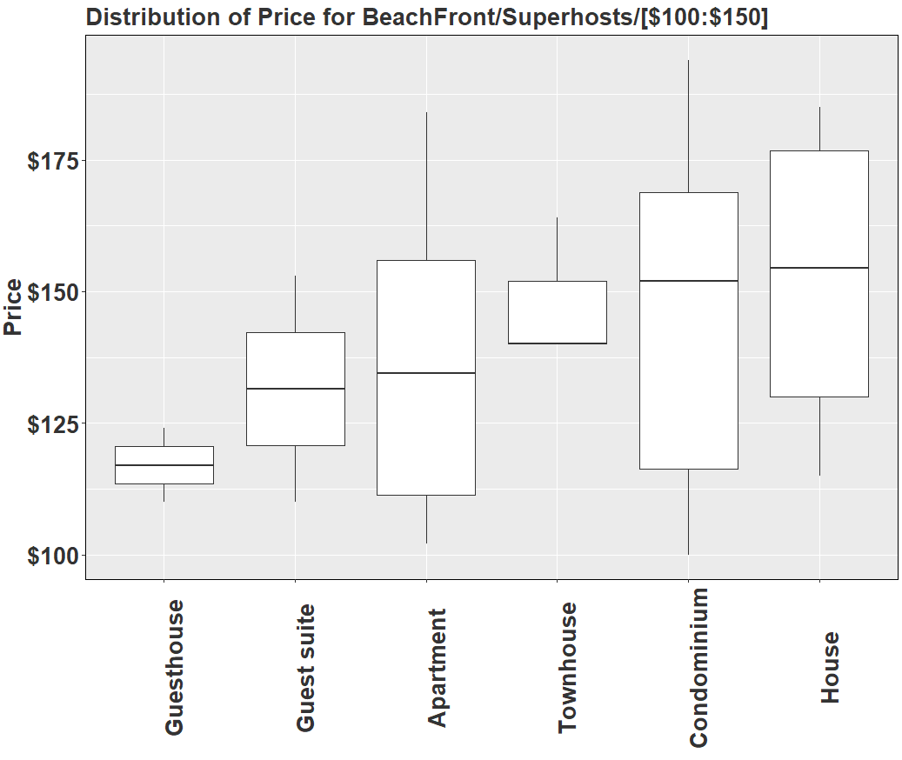
Hawaii : Price Distribution PER PROPERTY TYPE

Slide 29
Summary
There are 39 Airbnb in Hawaii categorized as Superhosts and BeachFront in the Price Range of [$100:$150].
Guesthouse is cheapest property
Mean Price: $142
More properties on East side of Island than West side of Island

Slide 30
Next
Next, let’s examine the top 5 locations in Hawaii by property type

Slide 31
Top Five
Notes:
Aren’t you VP Student Life?

Slide 32
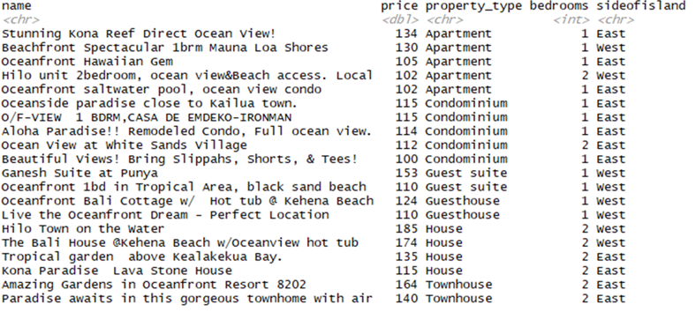
Top 5 Airbnb on Hawaii per Property Type
House and Townhouse most expensive

Slide 33


Top 5 Amenities featured by Hawaii airbnb
Superhost
Host

Slide 34
Summary
Notes:
Aren’t you VP Student Life?

Slide 35
Summary
Started with 16,618 Airbnb
Superhosts 6,776
Hawaii has 39 BeachFront Superhosts on Price Bin [$100:$150]
The Top 5 by property type are

Slide 36
Summary: Questions and Hypothesis
Q1. How does the rating and cost of the Airbnb effect it's success?
H1. A better rating will follow a Superhost.
A1. 5% higher ratings
Q2. How does price vary with location?
H2. The closer the Airbnb is to the beach, the more expensive the stay will be.
A2. $5 higher

Slide 37

THANK YOU

